Slide 1
Housing Trends in Central Texas
Team Members: Griselda Rodriguez, Michael Sanchez, Adil Baksh, Santiago Cardenas

Slide 2

PROJECT OVERVIEW
This project will analyze and visualize housing trends across Central Texas, focusing on homeownership rates, rental costs, and housing affordability. The goal is to understand how these factors vary across different regions and demographic groups over time.
Aims to identify and analyze factors influencing the housing trends in Central Texas by focusing on a four-year span (from 2018 to 2022).

Slide 3
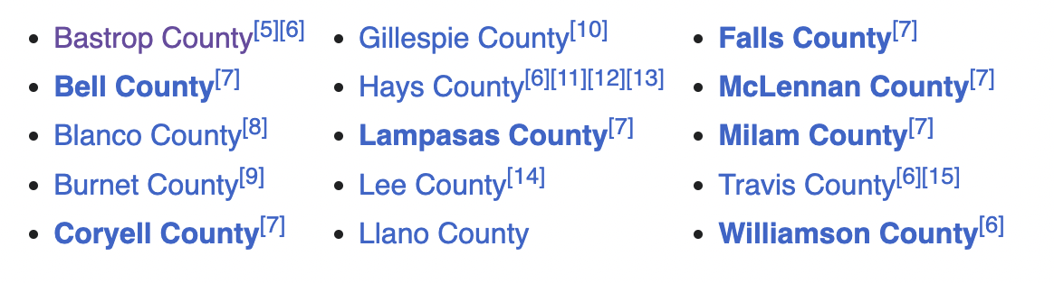
Data Sources
US Census Bureau: A Dataset that allowed us to get valuable information on housing trends through multiple API calls
Demographic data:
Median Contract Rent
Mortgage
Total Rented and Owned Units
Central Texas Zip Code: Excel file that will allow us to build our API call, which needs zip codes in its query in order to obtain the desire data (2018-2022).

Slide 4
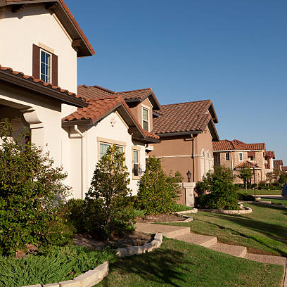
DATA STANDARDIZATION AND ANALYSIS
Data Standardization: Multiple API calls were made in order to obtain the necessary data for this project
Merged datasets: Created a new data frame merging all the data for their respective years (2018-2022)
Database: Used SQLite to create our database using the final csv files
Define Functions: Created functions to read and populate the tables as well as a function to create data frames for each year

Slide 5
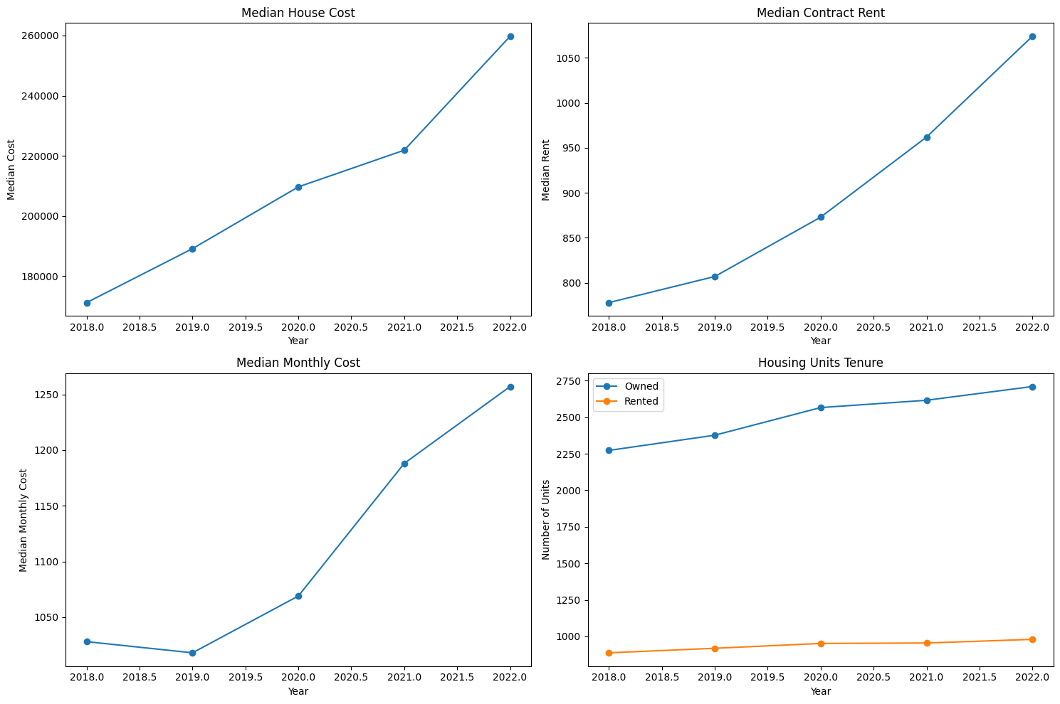
Median House Cost
Notes:
This includes the median cost of a home taken from all of the counties from 2018 to 2022. For the most part there was a steady increase of housing cost from 2018 to 2021, but this increase steeply increase between 2021 to 2022.

Slide 6

Median Contract Rent
Notes:
This is the median contract rent from all all zipcodes and as we could probably guess there is a steady increase of rent through the years 2018 to 2022.

Slide 7
Median Monthly Cost
Notes:
This is the median monthly cost of a owning a home. This includes costs that are associated with mortgage, home maintenance, and other costs that are associated with home ownership. This is a comparative measure to median rent. Despite a slight increase from 2018 to 2019, there was a steady increase of costs from 2019 to 2022.

Slide 8
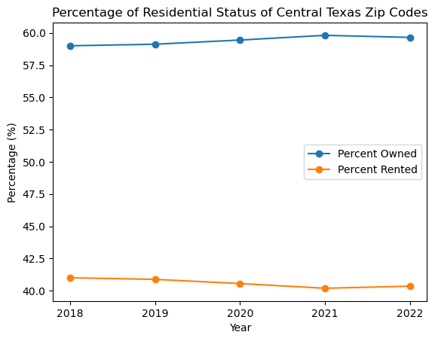
Percentage of Residential Status of Central Texas
Notes:
This is percentage of homeowners versus renters of all housing units within our search area and surprisingly there is a larger percentage of home owners over the last few years. There is sa notable increase of renters from 2021 to 2022. Based on current news there may be a different outlook and we hope to see this in the future when more information comes out the next few years.

Slide 9
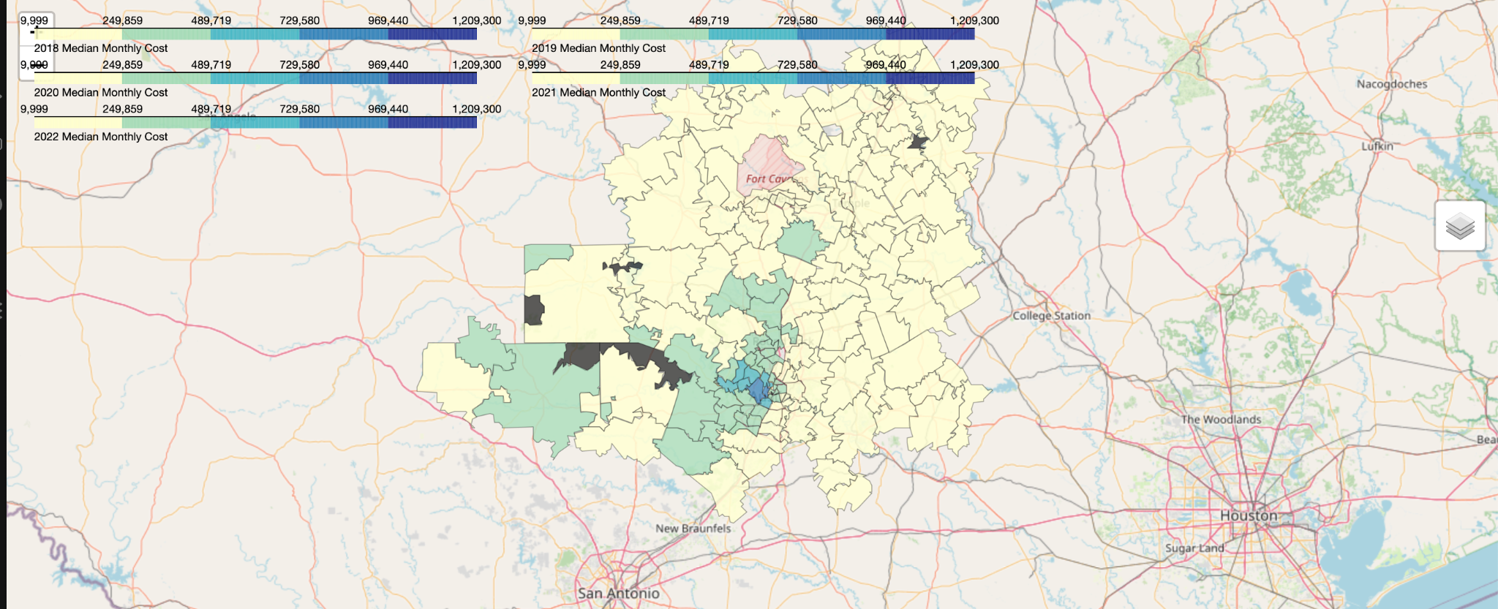
Median Cost of Home 2018-2022

Slide 10
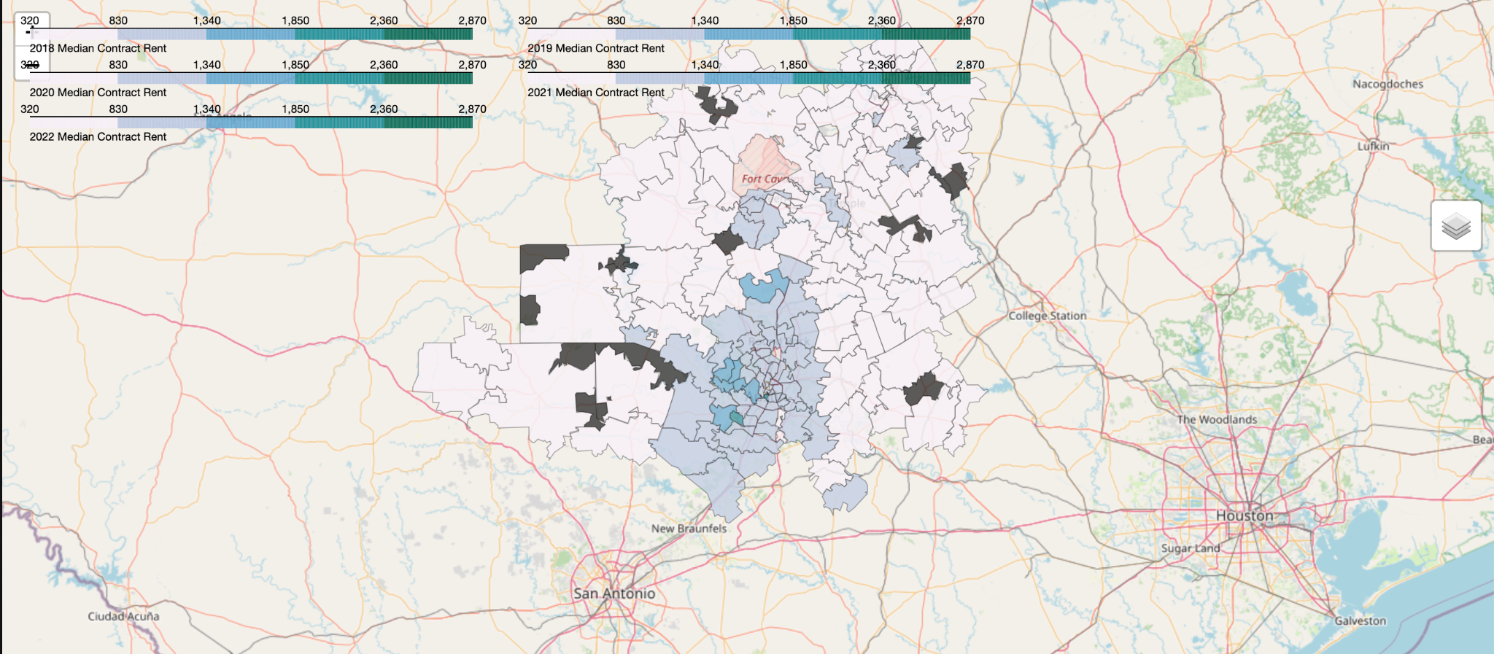
Median Contract Rent 2018-2022

Slide 11
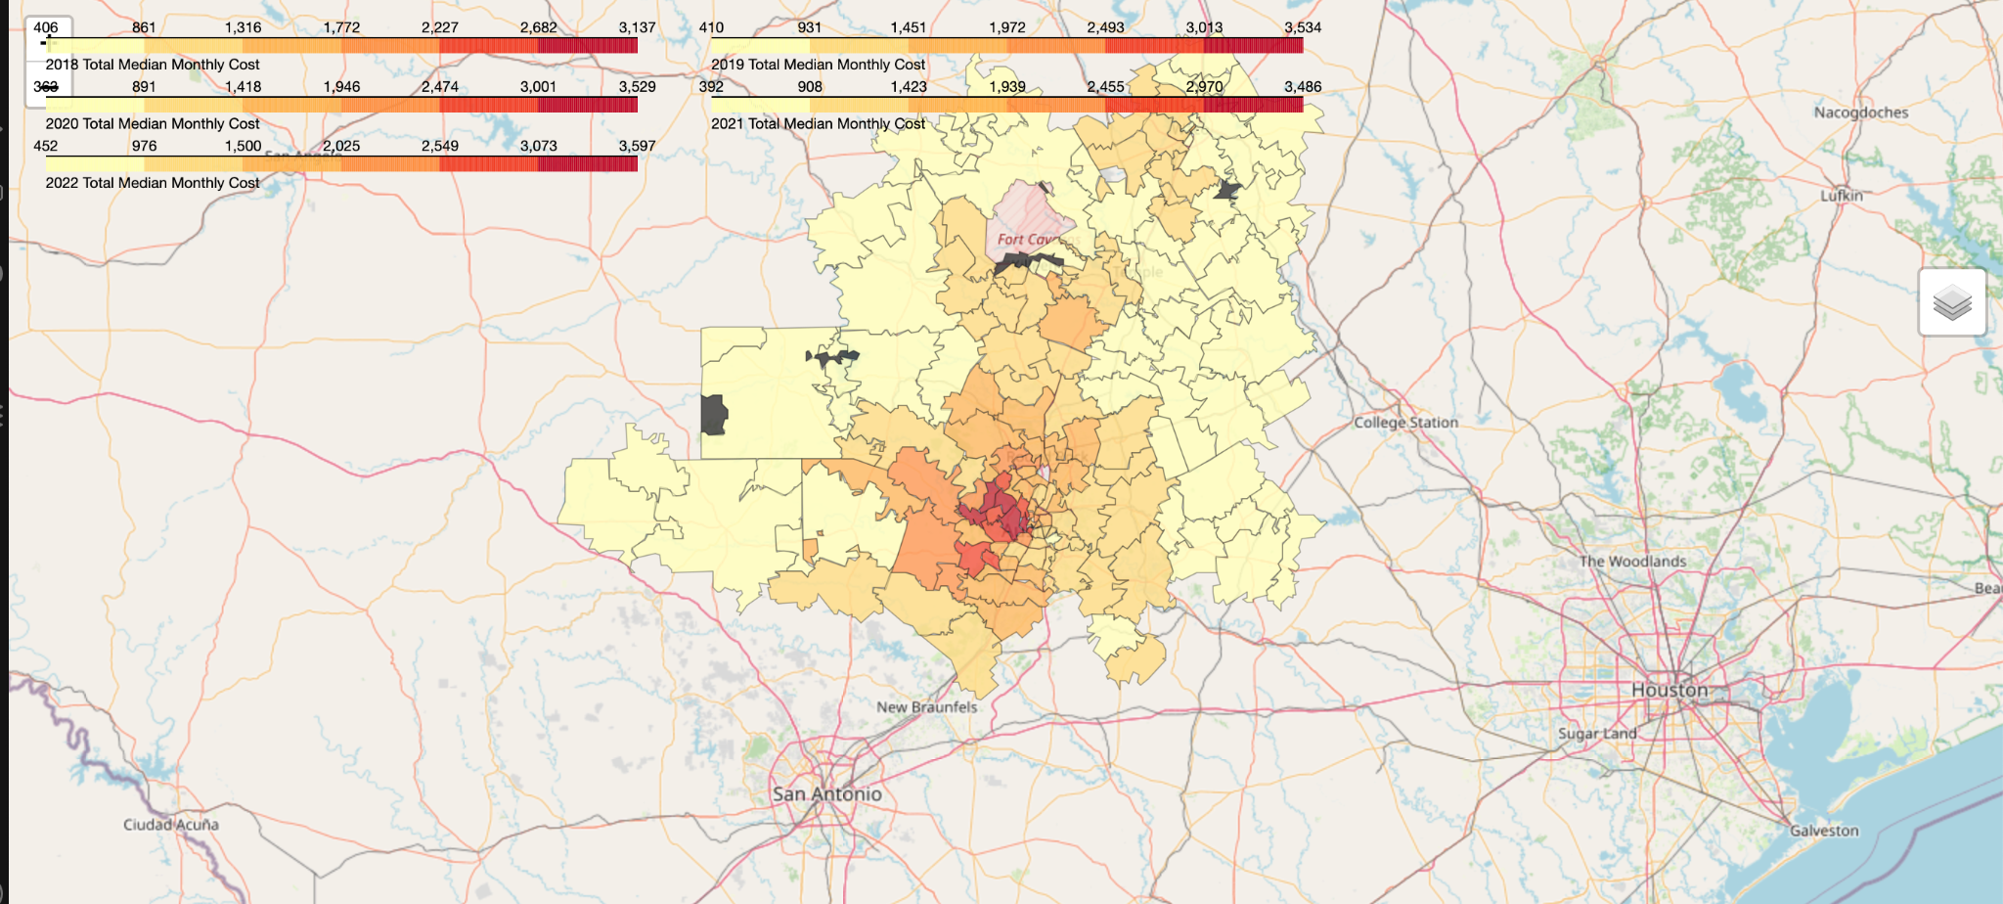
Total Median Monthly Cost 2018-2022

Slide 12
Overall Conclusion
Overall, the cost is increasing, but more so from 2020 to 2022
Based on the choropleth map, we can see that the median cost of homes, median contract rent, and the median monthly cost of home are increasing, specifically in the surrounding Austin area.
In other words, the best area to rent or own a house that does not hurt the budget would be outside of the Austin area.

Slide 13
FUTURE WORK
Incorporate Additional Data Sources:
Include more datasets, such as local economic indicators, crime rates, school district quality, or public transportation access. This could provide a more comprehensive view of what influences housing trends.
Expand the Time Frame:
Extend the analysis to include more recent data beyond 2022 or go further back to analyze long-term trends.
Predictive Modeling and Machine Learning:
Develop predictive models using machine learning techniques to forecast future housing trends based on historical data.

Slide 14

Thanks!
Any question?

